Slide 1
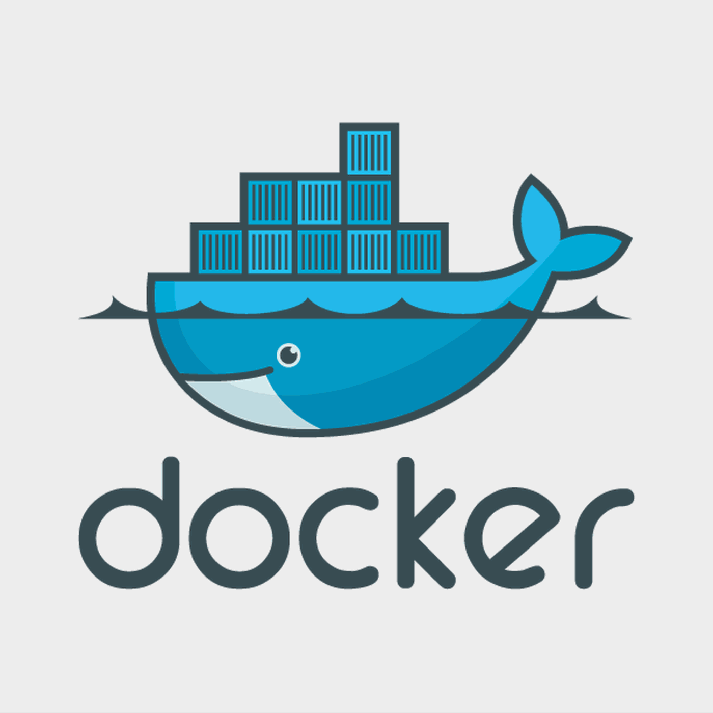
Application Containerization
Hitesh Kumar Sharma
Technical Trainer

Slide 2
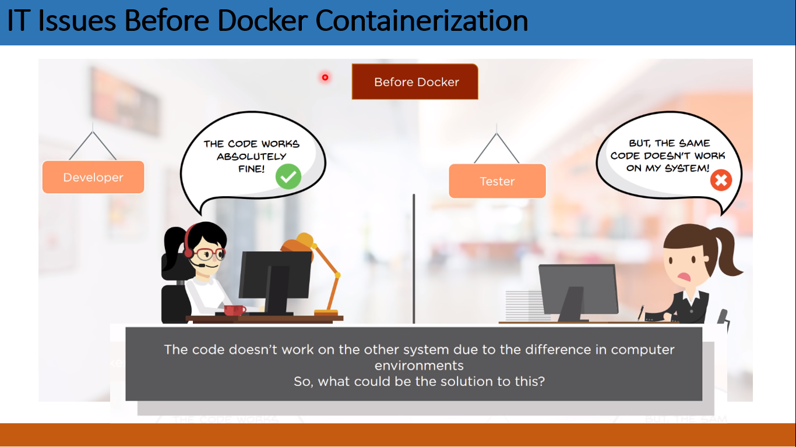
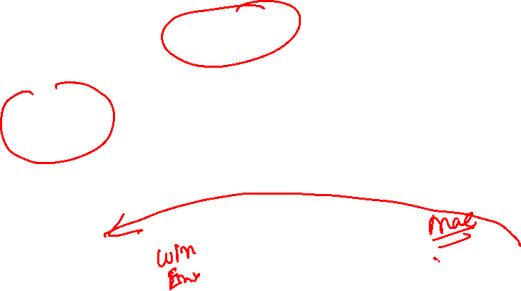
IT Issues Before Docker Containerization

Slide 3
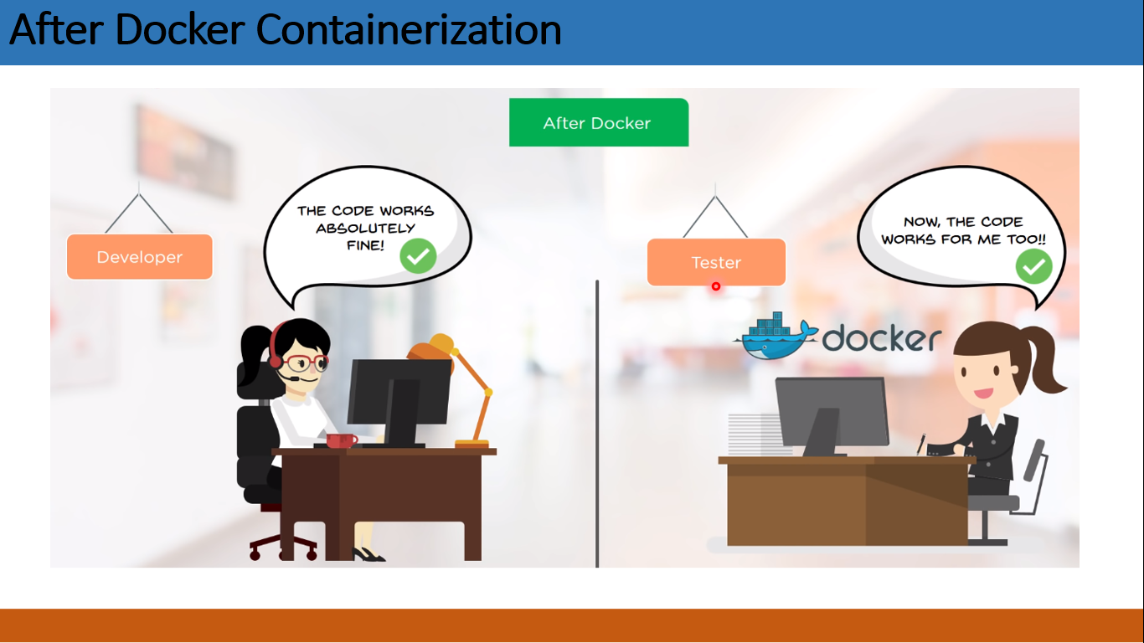
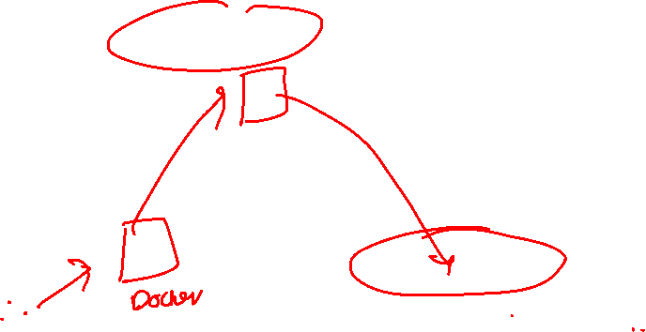
After Docker Containerization

Slide 4
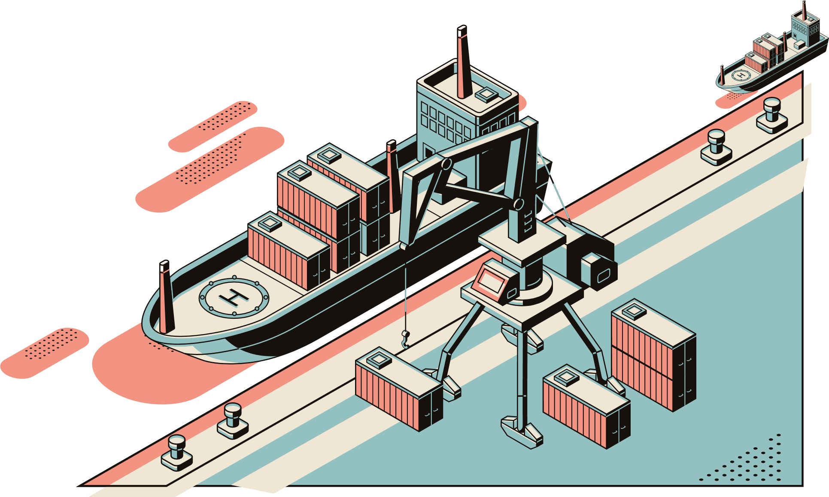
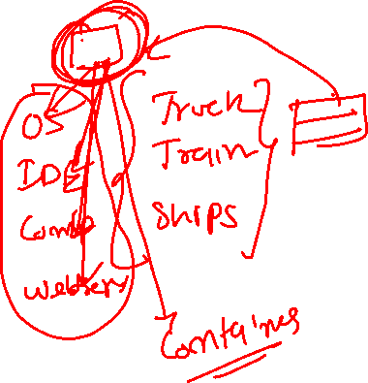
1.1 Transporting Goods Analogy
Notes:
Notes to the Facilitator: Explain containers with the transporting goods analogy.
Notes to the Participants:
Before 1956, shipping industry was in haphazard because of the way goods were being shipped. Goods were carried by a swarm of workers who carry the goods on their back, climb up the gangplank and stacking them on the ship. The ship holds the all varieties of goods which can be imagined, ranging from tough to fragile. And they were kept at the same place until the ship gets unloaded or goods got deployed on the dock. By then, most of the goods get damaged, perishable goods get perished. Moreover, all of these goods were picked by hands irrespective of their fragility. The results of such strategy were: shipping goods were a disastrous, manual effort, such shipping demerits deter many industries to engage in overseas trade.
Then came containers, due to which goods of the same category were safely stacked inside a container, which led to less damaging of goods, easy shipping, reduction in cost, big cranes loading-unloading the containers with dexterity. Containers changed the overall shipping industry model which attracted other industries to participate in the global trade. Now, if you compare this analogy with software deployment you can identify the similar flaws, like various services are running on a single server hampering each other because of shared space, deploying them is crucial because of dependencies required on the host systems. What if something like shipping containers can be used in software world, then managing containers will become quite easy.
For that we have container technology in place, where we can put all our dependencies in an isolated environment and ship them over a network without worrying about the configuration on host machines. This makes shipping code among different environment easier.

Slide 5
1.2 Problems in Shipping Industry before Containers
The shipping industry faced the following problems before containers:
Shipping fragile goods with robust ones
Shipping of edible food items with raw materials
Shipping of cars
Shipping of various goods via different mode of transports like railways, roadways, airways, waterways, etc.
Loading and unloading of goods
Notes:
Notes to the Facilitator: Describe the issues of shipping different types of goods together with different means of transport.
Notes to the Participants: As mentioned earlier, the shipping variety of goods wasn’t an easy task. People used to carry them on the back and stack them on ships. Suppose, a glassware was being stacked up along with the bathroom fittings on the same deck, a sudden swoosh of the waves and you lost the glassware. This will result in huge loss and decrease the reputation of the shipping company. Now, imagine a whole ship stacked up with small packets of variety of goods lying on the deck, the level of chaos is unimaginable. Along with that there won’t be much floor area left to carry more goods, which will not be a profitable solution.
Apart from carrying them on the ship, they need to traverse via road and other means of transport, which means they will be moved here and there on the roads which will increase the chances of damage.

Slide 6
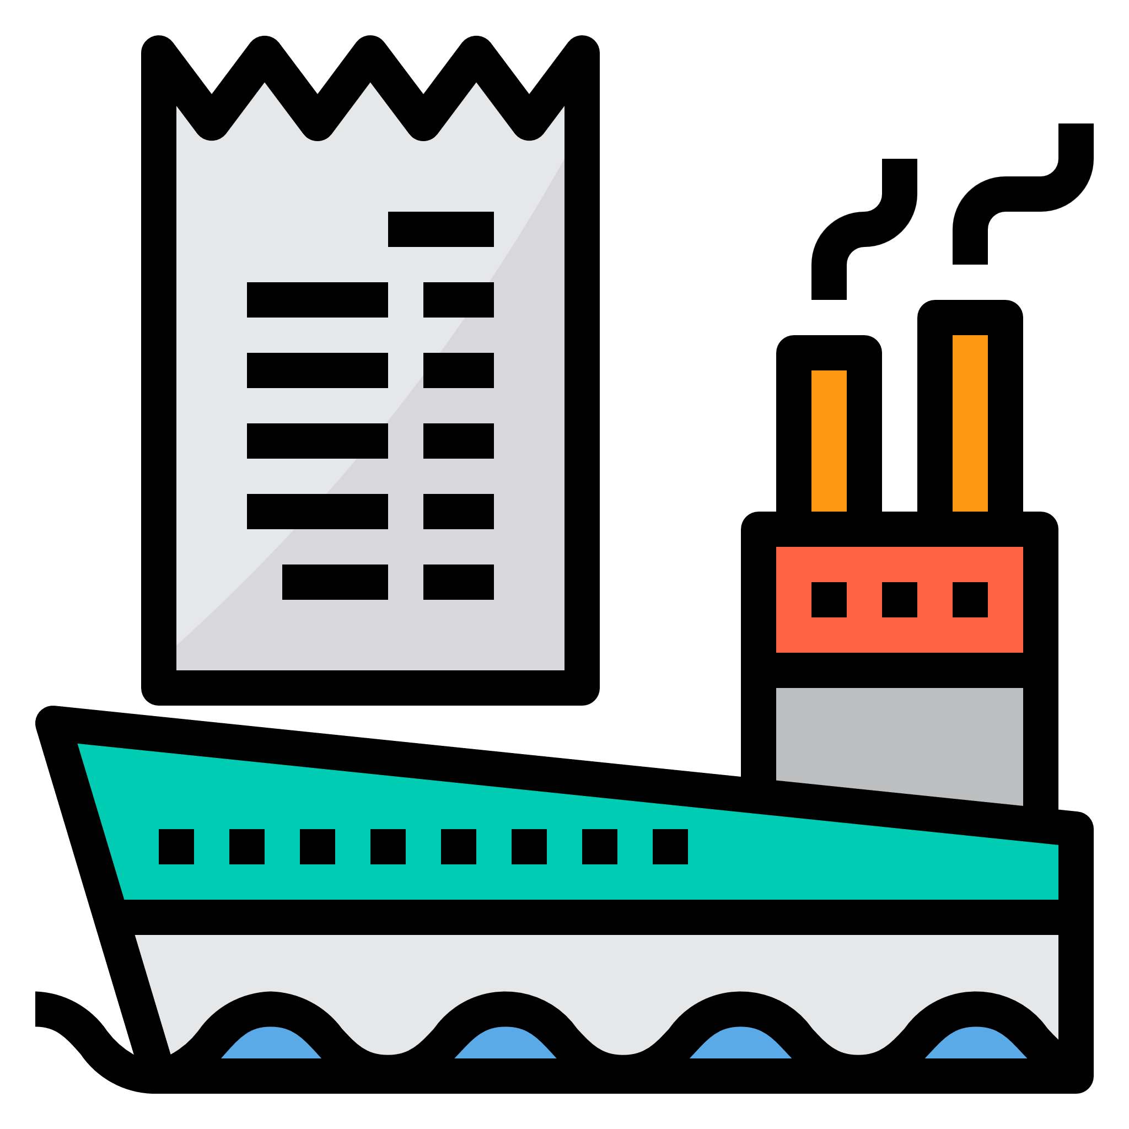
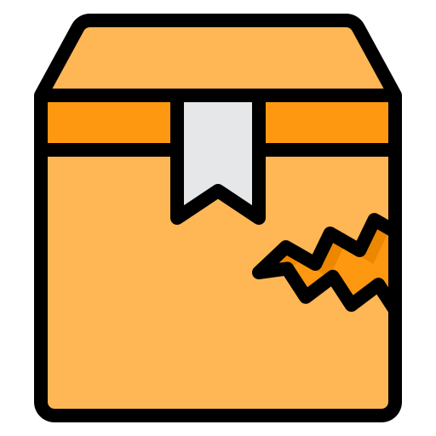
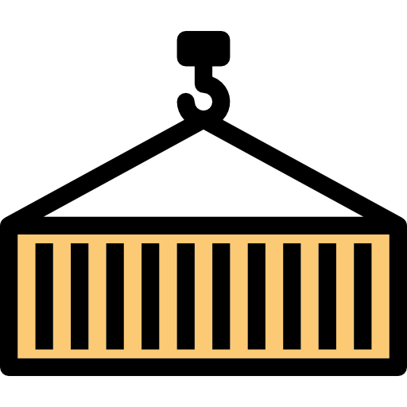

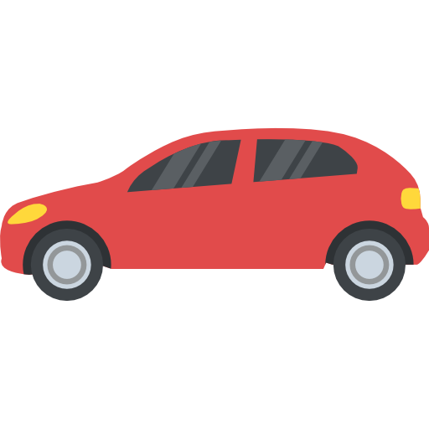
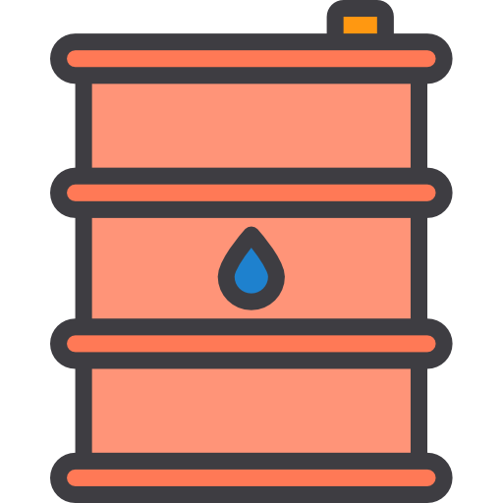
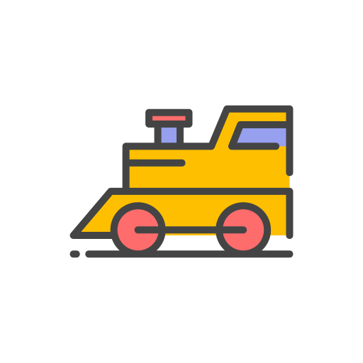
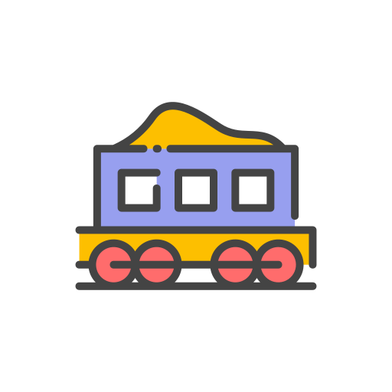
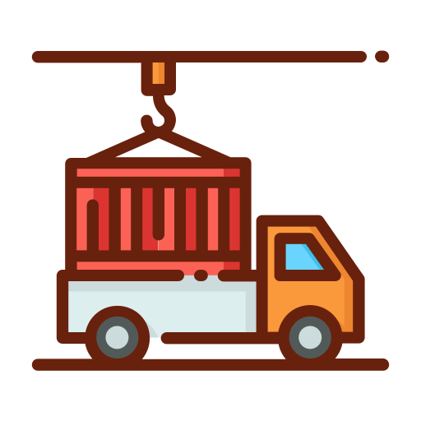
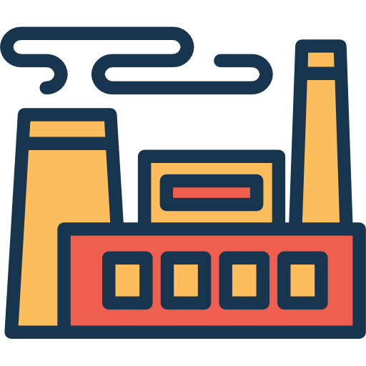
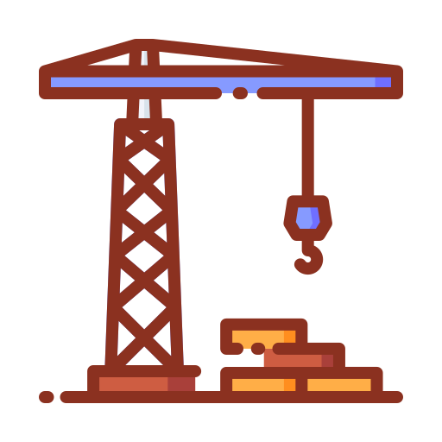
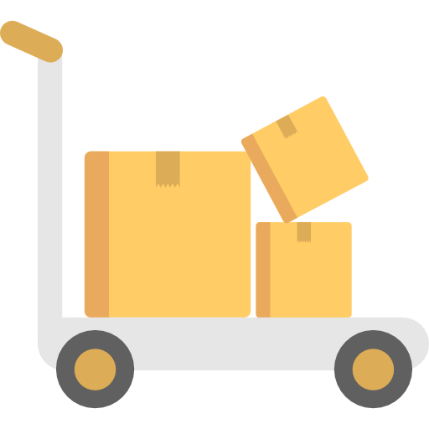
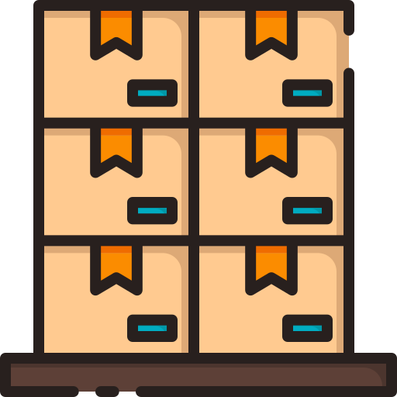
1.3 Shipping Industry Challenges
The various challenges faced by the shipping industry.
Multiplicity of goods
Do I worry about how goods interact? (e.g., coffee beans next to spices)
Multiplicity of methods for transporting/storing
Can I transport quickly & smoothly? (e.g., from boat to train to truck)
Notes:
Notes to the Facilitator: Inform the participants about the challenges faced by shipping industry.
Notes to the Participants: The one major problem faced by shipping industry was stacking up different types of goods together, which was resulting in damaged goods. So when the containers came into the picture, they ensured that fragile goods to be stored in one container and the same goes for other kinds of goods. Thus, when a glassware was being stacked in one container, all sorts of dependencies was being enclosed in that particular container, like wrapping up glassware in foam and cardboard to avoid breakage. And an organized container stacks allowed better resource utilisation in terms of floor area, since containers can be stacked upon one another.
In the picture, we can see different goods like:
Cars
Wine
Oil tanks
Piano
Servers
Spices
Fruits
The way to ship them is also different depending upon their fragility. Therefore, the main challenges were as follows:
How to be sure that the cargo of a port wine company won't damage or contaminate the cargo of another company?
How to isolate the cargo?
How to be sure that the cargo is inviolate?
How to make sure that the cargo is being transported in the best conditions (correct temperature for instance)?

Slide 7
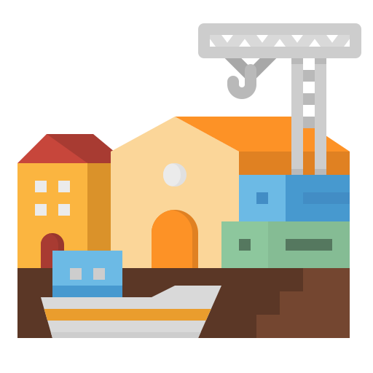
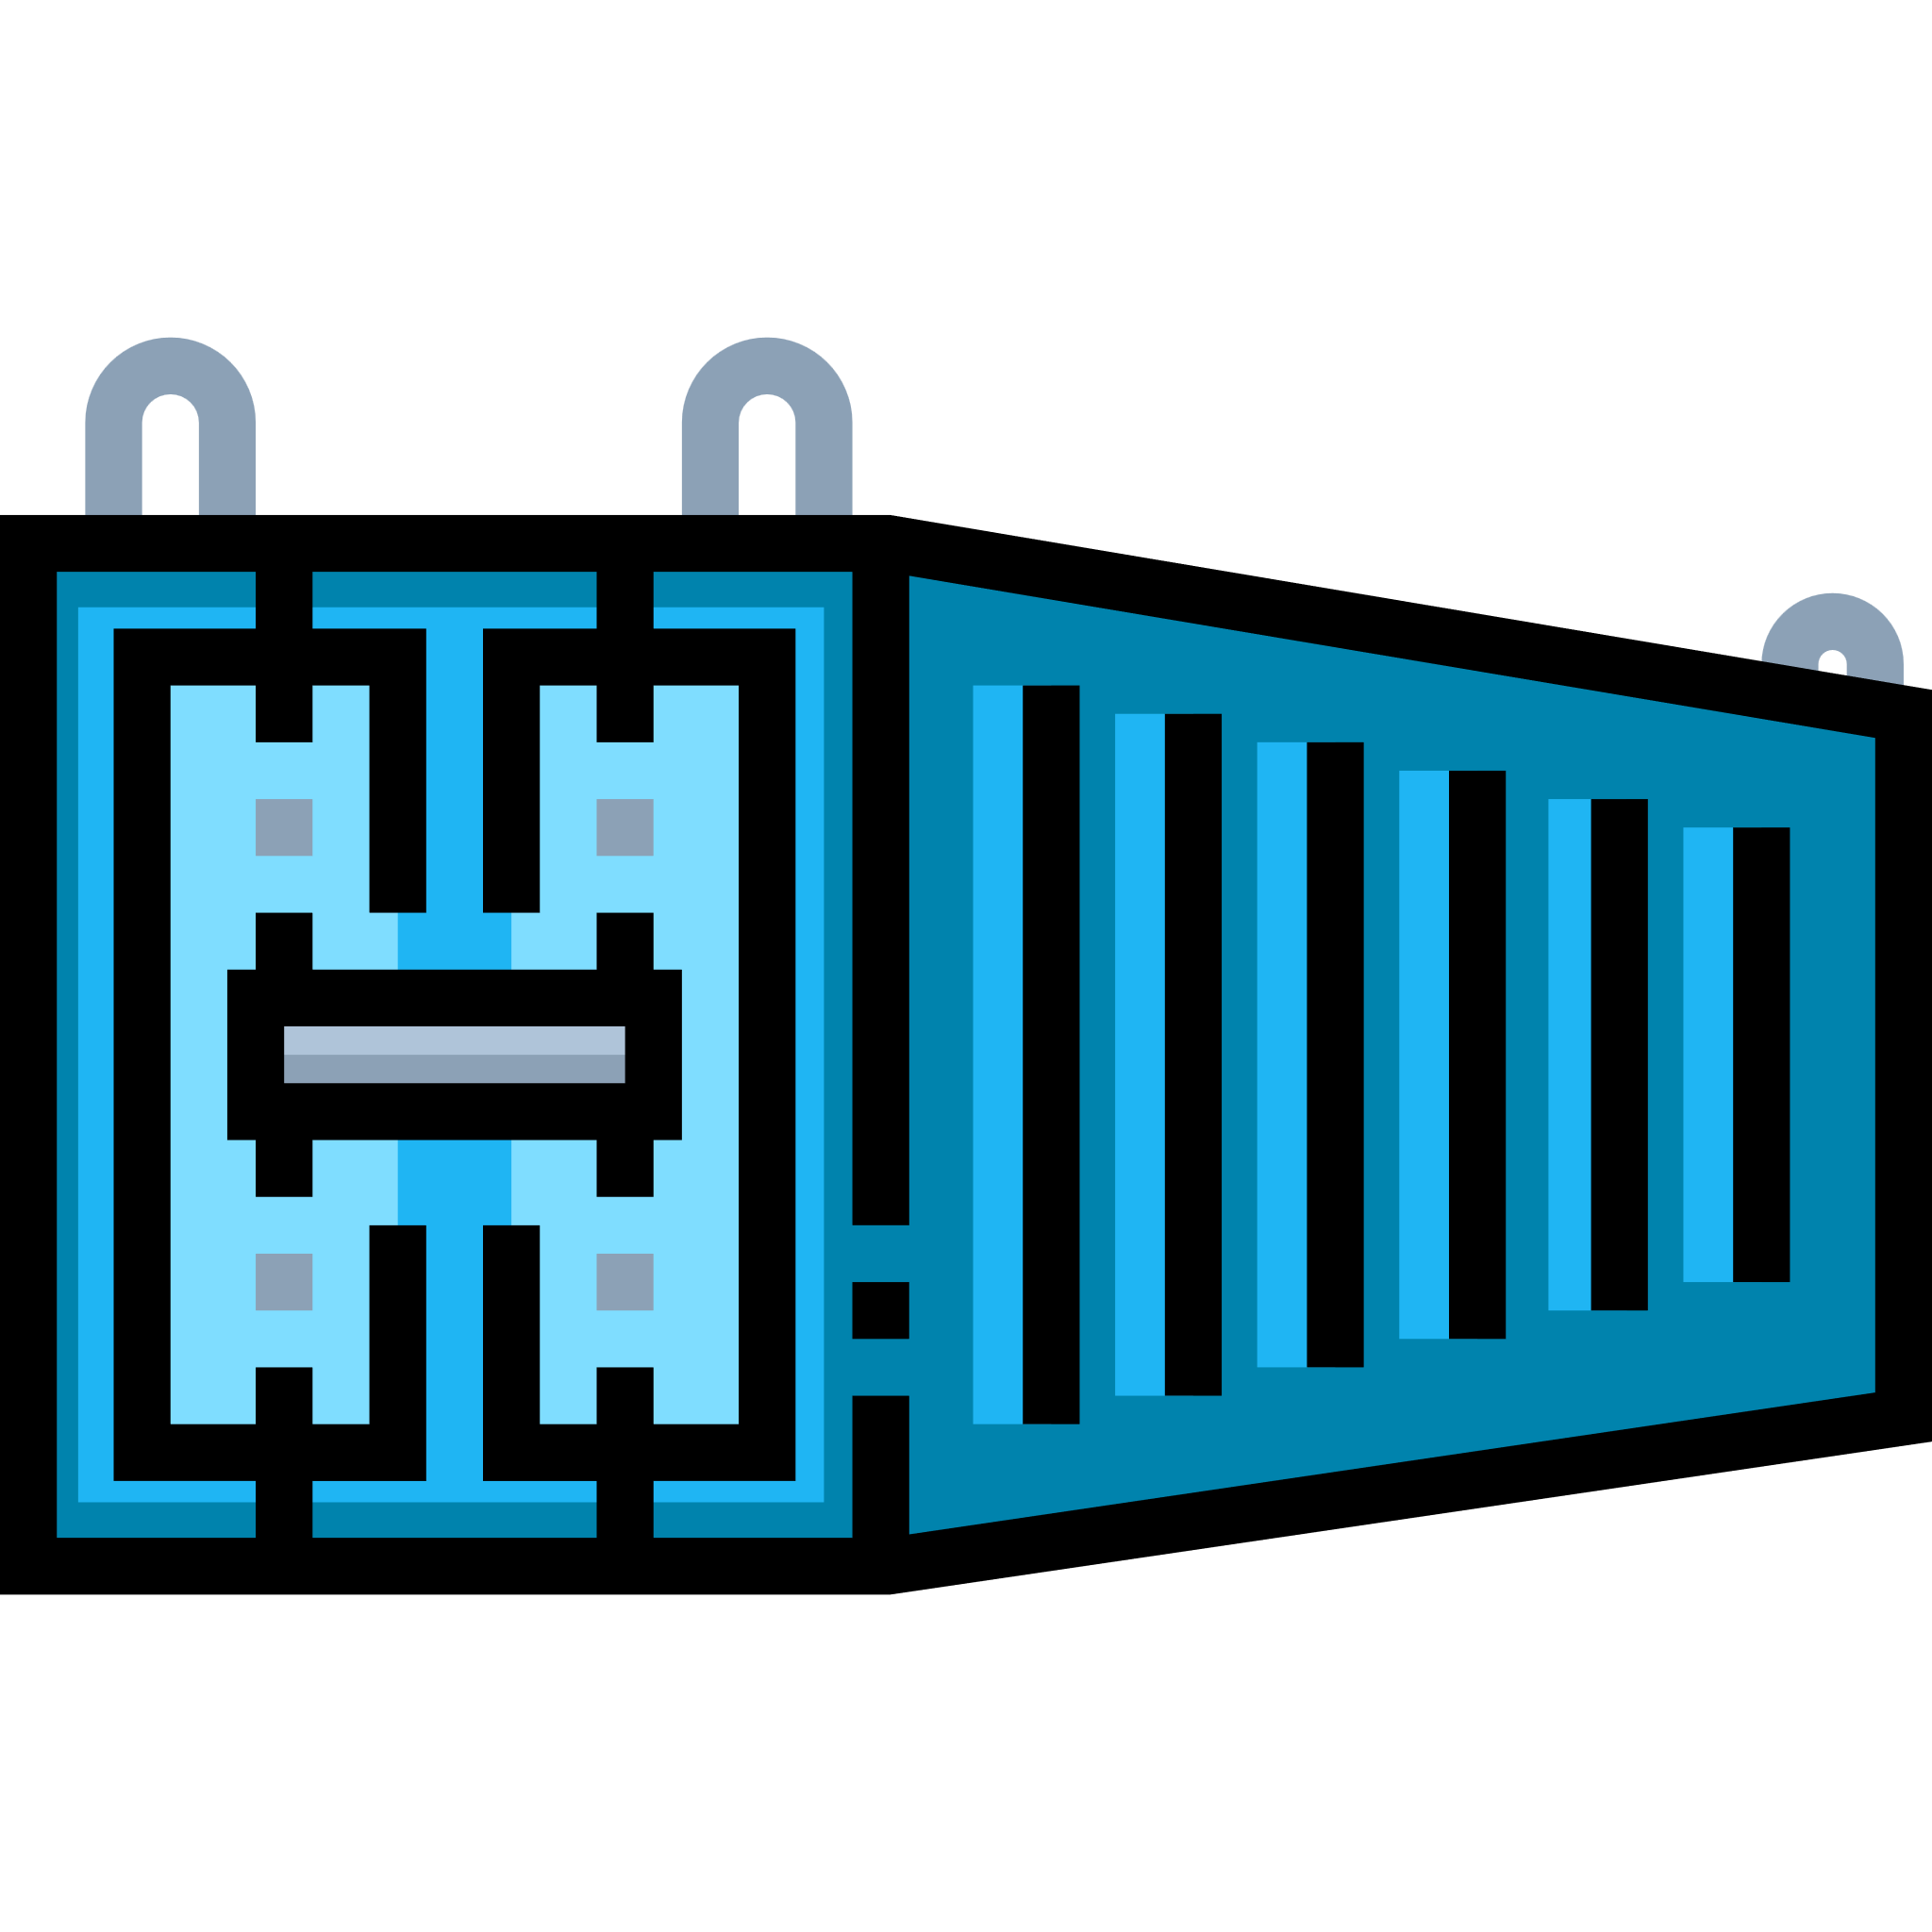
1.4 Container: The Saviour
How did the container become the saviour?
Multiplicity of goods
Do I worry about how goods interact? (e.g., coffee beans next to spices)
A standard container that is loaded with virtually any goods, & stays sealed until it reaches final delivery.
Multiplicity of methods for transporting/storing
Can I transport quickly & smoothly? (e.g., from boat to train to truck)
In between, can be loaded & unloaded, stacked, transported efficiently over long distances, & transferred from one mode of transport to the other.
CONTAINER
Notes:
Notes to the Facilitator: Explain how containers solve the problem of shipping different types of goods together and use this analogy to explain shipping off different application stacks.
Notes to the Participants: If we put things in a container isolating them from the other, then it will solve most of the problems. Let’s discuss them in detail here: Challenge-1: How to be sure that the cargo of a port wine company won't damage or contaminate the cargo of another company?
Solution: Since, we have put cargos of different merchants in different containers, there is no chance that things would contaminate each other.
Challenge-2: How to isolate the cargo? Solution: We can isolate the cargo by keeping different variety of goods in separate containers, which will isolate them from each other.
Challenge-3: How to be sure that the cargo is inviolate?
Solution: Each container will have compartments which are stacked up with soft material, which will safeguard the goods from getting damaged.
Challenge-4: How to make sure that the cargo is being transported in the best conditions (correct temperature for instance)?
Solution: Suppose, we have put all the fruits in a single container, so that we can manage the environment inside it, like deep freezing it. Thus, they won’t get stale.

Slide 8
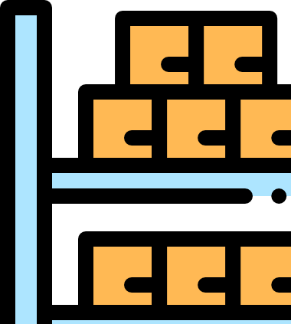
1.5 Solution by Containers in the Shipping Industry
Everything falls into place with the help of containers.
Notes:
Notes to the Facilitator: Discuss the how everything works fine with containers.
Notes to the Participants: So, as you can see that everything falls into place with the help of containers. According to the image;
Now all of the Wine will be stacked in one container which can be shipped over ship, trucks or by any other means, and won’t get damaged because they are protected with soft material.
Oil containers will not contaminate and smudge the other goods since the oil container has spilled proof shield around it.
Cars won’t get scratched as they are nicely placed inside the container locked by the hinges.
The Piano can now be safely shipped without any damage.
Fruits and spices are shipped under appropriate temperature, protecting them to get ruined because the container has refrigeration.

Slide 9

1.6 Challenges in the Software Industry
The various challenges in the software industry are as follows:
The multiplicity of environment
Hardware maintenance
Backup restore
2
4
6
1
3
5
7
The multiplicity of stacks
My own laptop
Disaster recovery
Disaster recovery
Notes:
Notes to the Facilitator: Discuss the various issues in the software industry.
Notes to the Participants: The various challenges in the software industry are as follows:
The multiplicity of stacks: In most of the software organization, the tech stack is quite diverse in terms of Applications (JAVA, Python, Go, PHP, .net), Platform (Linux, Windows, Mac), Middleware (Caching, Queueing, etc.), Databases (SQL, NoSQL), etc. It happens most of the time that keeping multiple dependencies on a single server could end up in disaster because there won't be any isolation that would keep them separated.
The multiplicity of environment: To make the system robust, each of the applications undergoes various environments to prove its mettle like Development, Staging, UAT, Pre-prod and then production. It is necessary to meet the requirements of the application in each environment to function ideally. And, to achieve that we need a mechanism that will control such operations, avoiding any error due to manual intervention like Software Configuration Management.
My own laptop: One of the most heard statements is "It is working on my laptop, not on prod". To provide the same kind of environment, the code required should be uniform in all environments and platform.
Hardware maintenance: When our system is running on VMs or bare-metal, the underlying hardware sometimes goes under maintenance, which results in downtime if our infra is not dynamic.
Disaster recovery: When a VM goes down, it takes time to recover from that disaster even if you have the best strategy in place, but the duration of the recovery is long enough to have a downtime.

Slide 10

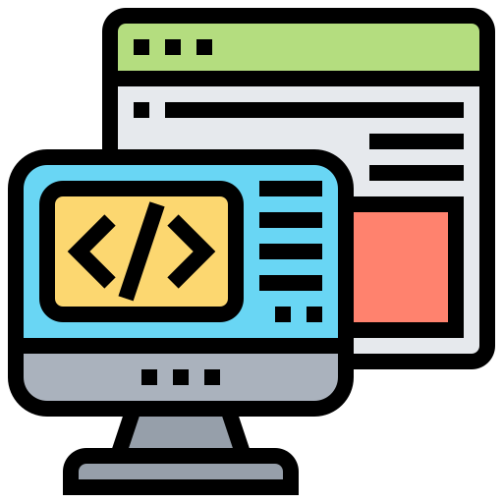
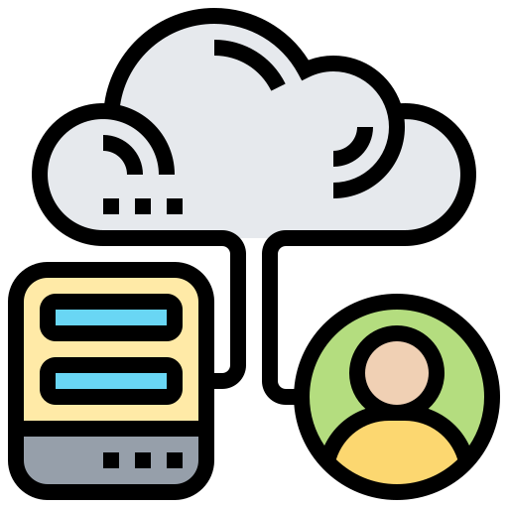
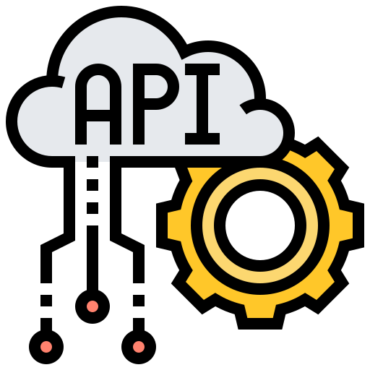

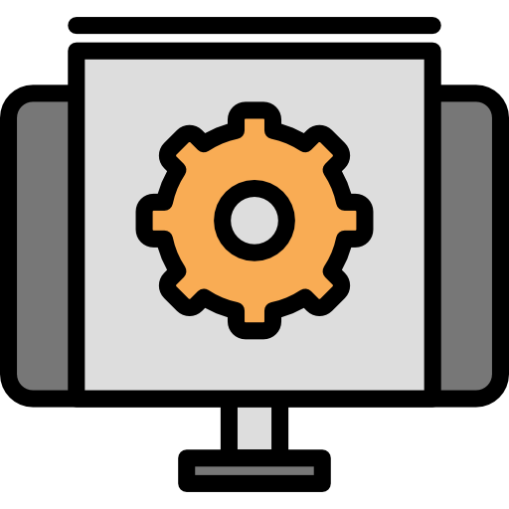
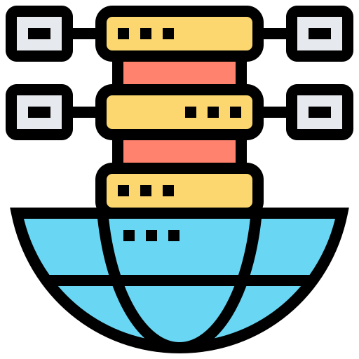
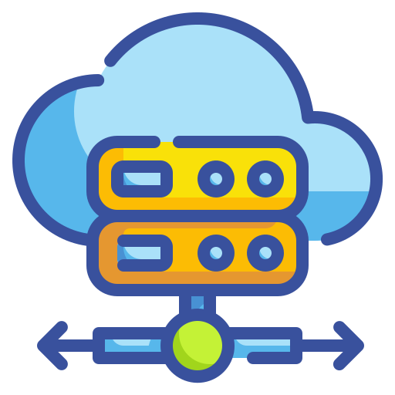
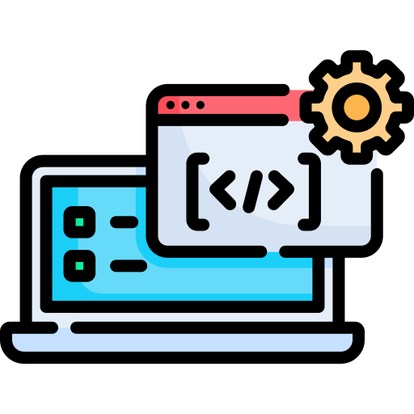

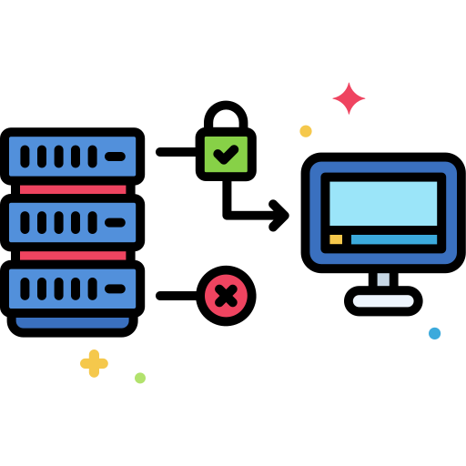
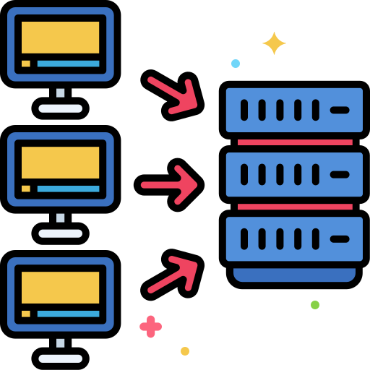
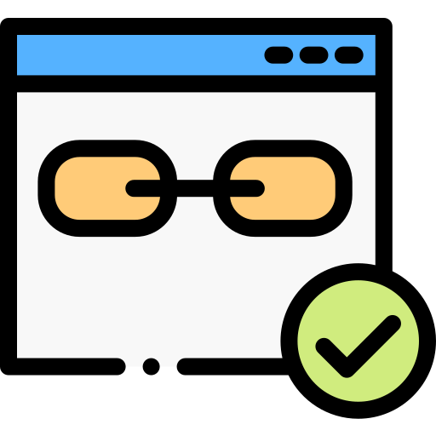
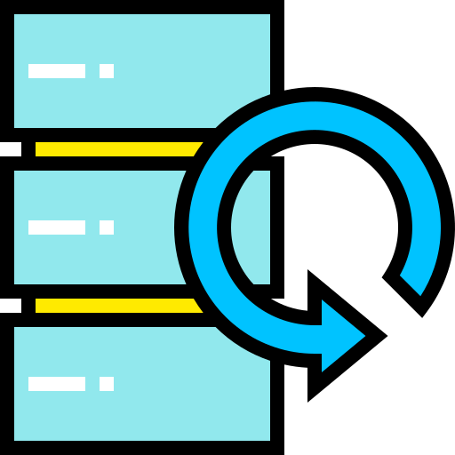

1.6 Challenges in the Software Industry (Contd.)
The various challenges in the software industry are as follows:
Do services & apps interact appropriately?
Multiplicity of Stacks
Background workers
Static Website
nginx 1.5, modsecurity, openssl, bootstrap2
Python 3.0, celery, pyredis, libcurl, ffmpeg, libopencv,nodejs, phantomjs
User DB
API Endpoint
postgresql, pgv8, v8
Python 2.7, Flask, pyredis, celery, psycopg, postgresql-client
Web frontend
Queue
Ruby, Rails, sass, Unicorn
Redis, redis-sentinel
Can I migrate smoothly & quickly?
Multiplicity of hardware environments
Development VM
Customer Data Center
Contributor’s laptop
Public Cloud
QA server
Production cluster
Data recovery
Production Servers
Notes:
Notes to the Facilitator: Discuss the various issues in the software industry.
Notes to the Participants:
Backup restore: If we consider the stateful applications, the major concern in their life cycle is to have a consistent backup if they are running on VMs, but if they go down you need to have a restore plan altogether, but this too cause downtime irrespective of how good is your restore strategy.
Disaster recovery: When a VM goes down it takes time to recover from that disaster even if you have the best strategy in place, but the duration of the recovery is long enough to have a downtime.

Slide 11
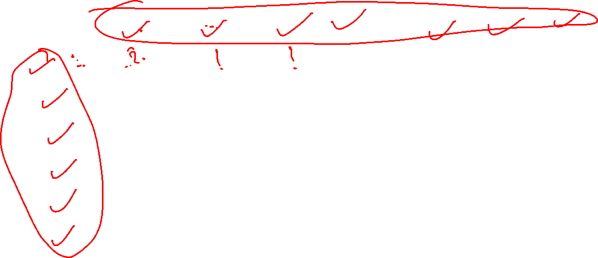
1.7 Problems in Software Industry Before Containers
The chaos in the software industry while managing diverse stack in different environments:
 | Development VM | QA Server | Single Prod Sever | Onsite Cluster | Public Cloud | Contributor Laptop | Customer Servers
Static Website | ? | ? | ? | ? | ? | ? | ?
Background Workers | ? | ? | ? | ? | ? | ? | ?
Web Front End | ? | ? | ? | ? | ? | ? | ?
User DB | ? | ? | ? | ? | ? | ? | ?
Analytics DB | ? | ? | ? | ? | ? | ? | ?
Queue | ? | ? | ? | ? | ? | ? | ?
Notes:
Notes to the Facilitator:
Explain the chaos in the software industry while managing diverse stack in different environments.
Notes to the Participants:
As you can see the Matrix in the picture, we have stacks like:
Tech Stack
Static website: A website that will be hosting static content written in HTML with a few images.
Web frontend: Also called a client-side application end written in HTML, CSS, and Javascript for a web application.
Background workers: They are simple independent threads in the application running in the background, they are literally the workers which helps in serving the application.
Users DB: A database where my application is ingesting data and retrieving data when my user is accessing the application.
Analytics DB: A database from which all sorts of reports are generated for analysing the business progress.
Queue: It is a stream-processing software platform, to publish and subscribe to streams of records, similar to a message queue or enterprise messaging system and store streams of records in a fault-tolerant durable way.
We will discuss about platforms in the next slide.

Slide 12
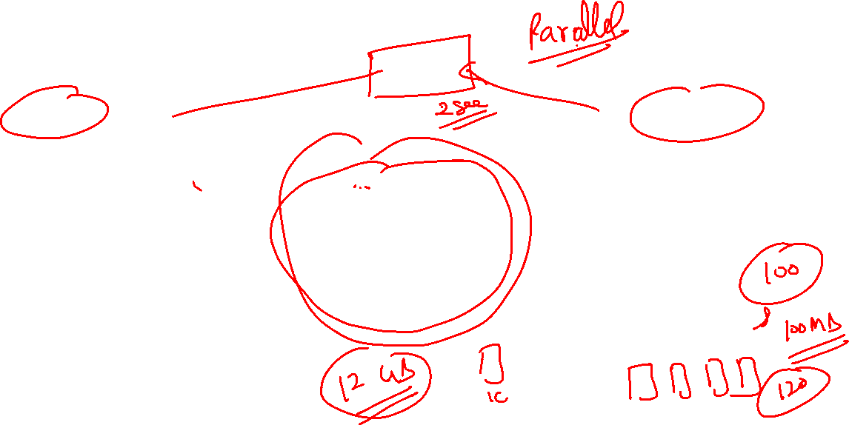
1.8 Put that in Container!
Multiplicity of stacks
Multiplicity of hardware environments
Developer: Build once, run anywhere(finally)
Operator: Configure once, run anything
Static Website
Development VM
nginx 1.5, modsecurity, openssl, bootstrap2
User DB
Production Servers
postgresql, pgv8, v8
Web frontend
Customer Data Center
Ruby, Rails, sass, Unicorn
Background workers
Contributor’s laptop
Python 3.0, celery, pyredis, libcurl, ffmpeg, libopencv,nodejs, phantomjs
QA server
API Endpoint
CONTAINER
Production cluster
Python 2.7, Flask, pyredis, celery, psycopg, postgresql-client
Data recovery
Queue
Redis, redis-sentinel
Source: https://encrypted-tbn0.gstatic.com/images?q=tbn:ANd9GcRWHcB-4JmViuSdW3tEtckQ2HLOrIhv-AnO9_6jzUohl1NmPyOV&s
Notes:
Notes to the Facilitator:
Discuss how putting the application in a container solves the issues faced by the software industry while managing diverse stack in different environments.
Notes to the Participants:
The problems which we discussed can be solved if we put things inside a container. Suppose, we have two application which needs to be run on the same VM, one of them runs on python2.7 and other runs on python3. While running both of the applications, we have injected the versions of python as environment variables. If the environment variables are overlapped then both of the applications will suffer. And If we compare this respect to resource utilisation, if there is no isolation at the process level, that means if any of the application starts consuming more resources it will try to kill the other application, which will bring vulnerability to the system. Solution
We can put those in separate containers like:
Container-1: It will have binaries of python2.7 along with the application-1 code.
Container-2: It will have binaries of python3 along with the application-2 code.
With this, the python version will not clash as both of the applications will be completed isolated because of containers. And we can put the limits on containers with respect to CPU and memory utilisation.

Slide 13

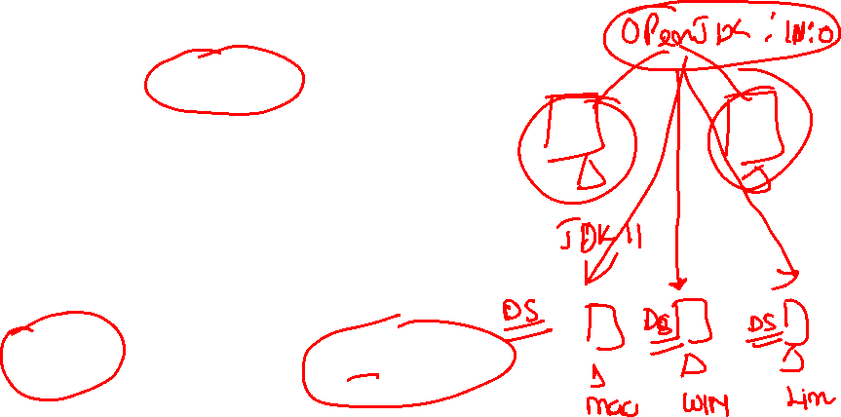
1.9 Solution by containers in the Software Industry
Keeping everything in container solves our problems easily on the factors below:
Consistency
Isolation
Run anywhere
Notes:
Notes to the Facilitator:
Explain how putting the application in a container solves the issues faced by the Software Industry and fils all the cells of the Matrix.
Notes to the Participants:
Putting everything in container solves our problems easily on the factors below:
Consistency: The main benefit of container is that it is consistent among all the environments since it creates predictable environments that are isolated from other applications. A container includes all software dependencies which are needed by the application, such as specific versions of programming language runtimes and other software libraries. All this is consistent no matter where the application is getting deployed. This results in productivity DevOps and Dev teams spend less time debugging and diagnosing differences in environments, and more time shipping new functionality for users.
Run anywhere: Containers are able to run anywhere, enhancing Continuous Delivery and Deployment on Linux, Windows, and Mac operating systems on virtual machines or bare metal, on a Contributor’s machine or in data centers on-premises; and in the public cloud as well.
Isolation: Containers virtualize CPU, memory, storage, and network resources at the OS-level, providing developers with a sandboxed view of the OS logically isolated from other applications.

Slide 14
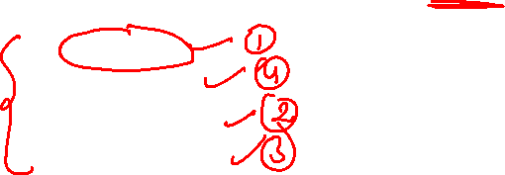
What did you Grasp?
Which is the key-factor which helped shipping and software industry to overcome the problems?
Isolation
Availability
Consistency
Performance
Notes:
Notes to the Facilitator:
Answer: A. Isolation

Slide 15
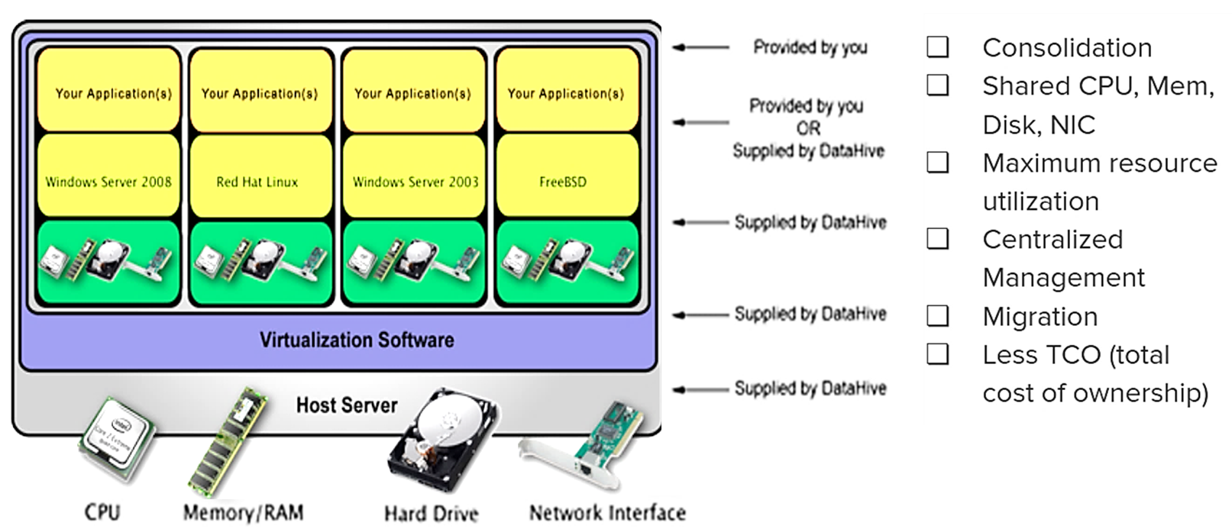
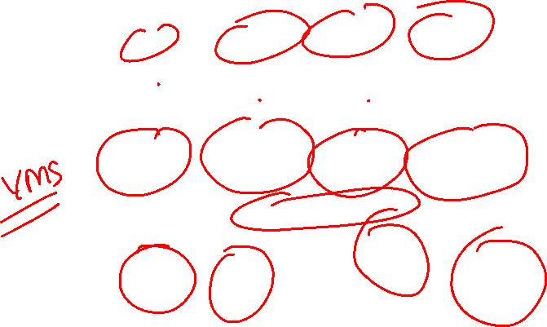
1.10 Virtualisation
Virtualization is a technology to run multiple same or different operating systems which are completely isolated from each other.
Notes:
Notes to the Facilitator:
Inform the participants about virtualization works in the software industry.
Notes to the Participants:
We have discussed how containers help in the software industry, but learning how virtualization works will help us to understand the core difference between the two.
Virtualization is a technology to run multiple same or different operating systems which are completely isolated from each other.
"Virtualization refers to the creation of virtual machines which have an independent Operating Systems, but the execution of software running on the virtual machine is separated from the underlying hardware resources. Also, it is possible that multiple virtual machines can share the same underlying hardware."

Slide 16
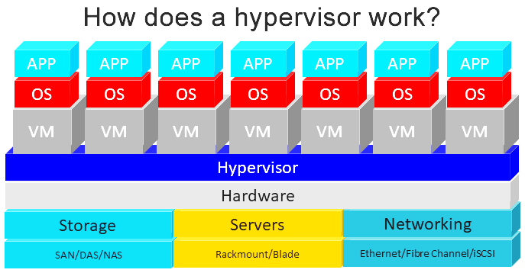
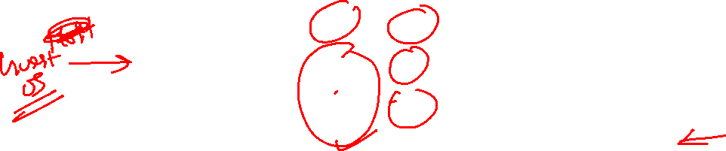
1.11 What is Hypervisor?
Source: https://www.data-storage.uk/articles/how-does-a-hypervisor-work/
Notes:
Notes to the Facilitator:
Describe what is hypervisor in virtualisation.
Notes to the Participants:
The hypervisor is a software layer which lies between hardware and operating systems and helps to interact with hardware and resources also provides an interface to share the available resources to virtual containers. Some of the common examples are VMware, Virtualbox, etc.

Slide 17
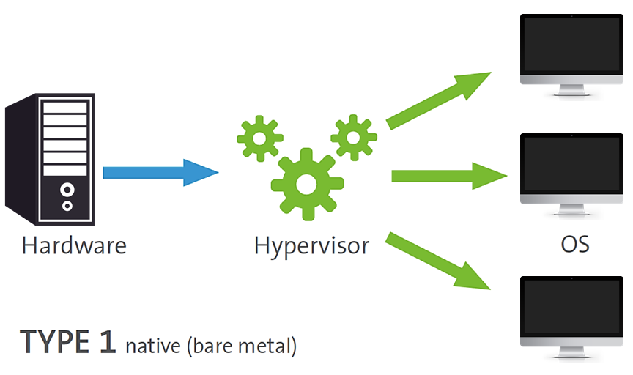
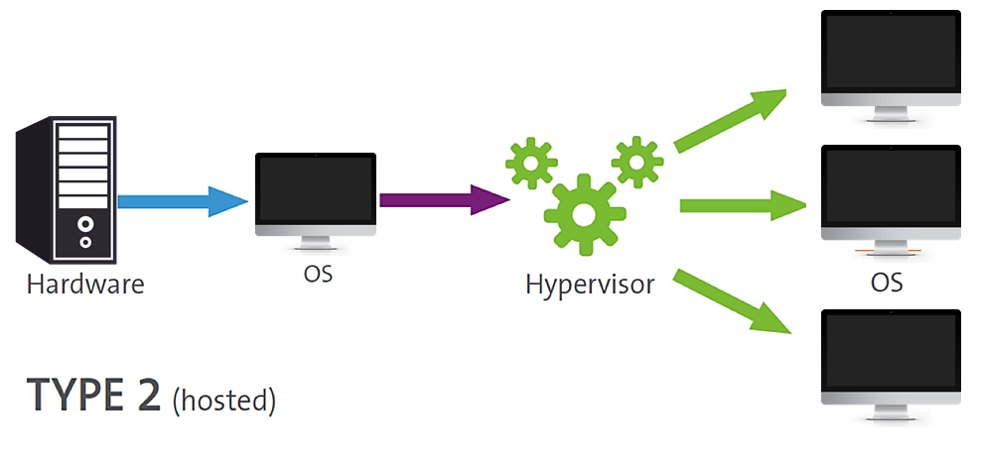
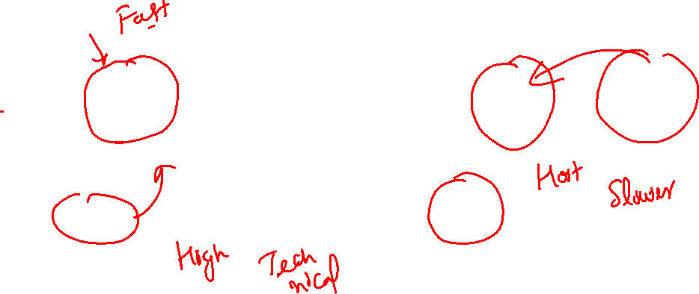
1.12 Types of Hypervisors
The two types of hypervisors are as follows:
Source: https://www.flexiant.com/2014/02/05/what-does-a-hypervisor-do/
Notes:
Notes to the Facilitator:
Inform the participants about the different types of Hypervisor in Virtualisation.
Notes to the Participants:
We know what Hypervisors are and what they do, but there are few hypervisors, which work with a slight differently to achieve the same objective. Let’s classify them into two. They are as follows:
Type-1(Native): Also called Bare Metal Hypervisor. In this type, the hypervisor sits on the top of hardware layer directly and provides interface to provision VMs.
Type-2(Host): In this type, the Hypervisor is installed on an OS that means it needs a host OS to sit on, like in development people use virtualbox for development.

Slide 18
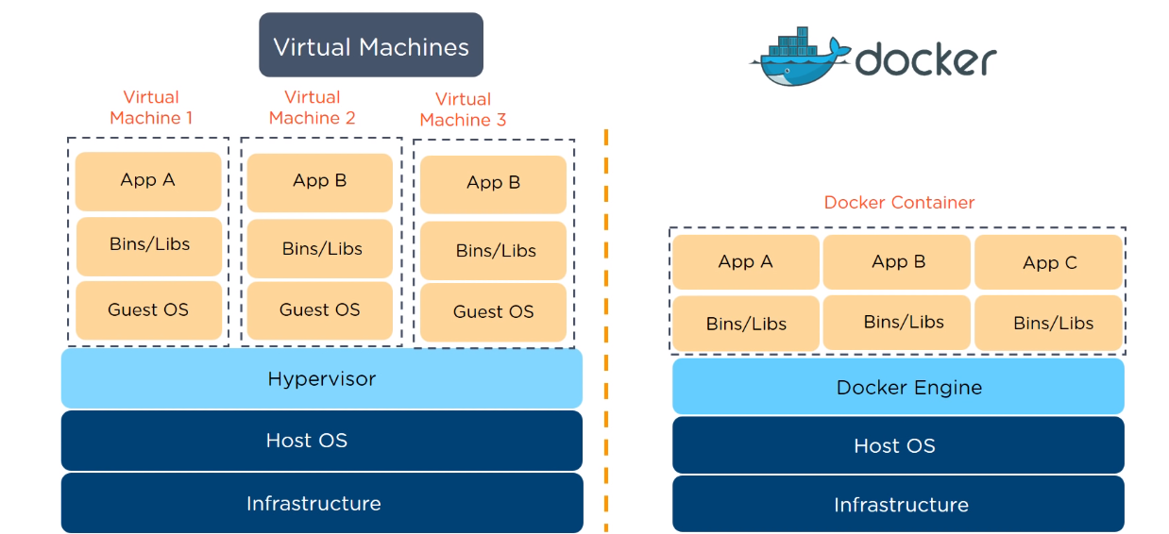
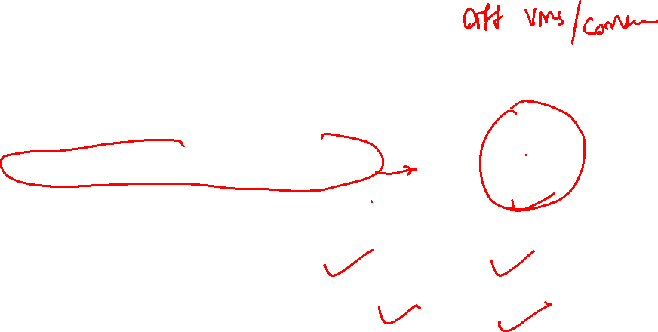
Virtual Machines vs Docker Containers

Slide 19
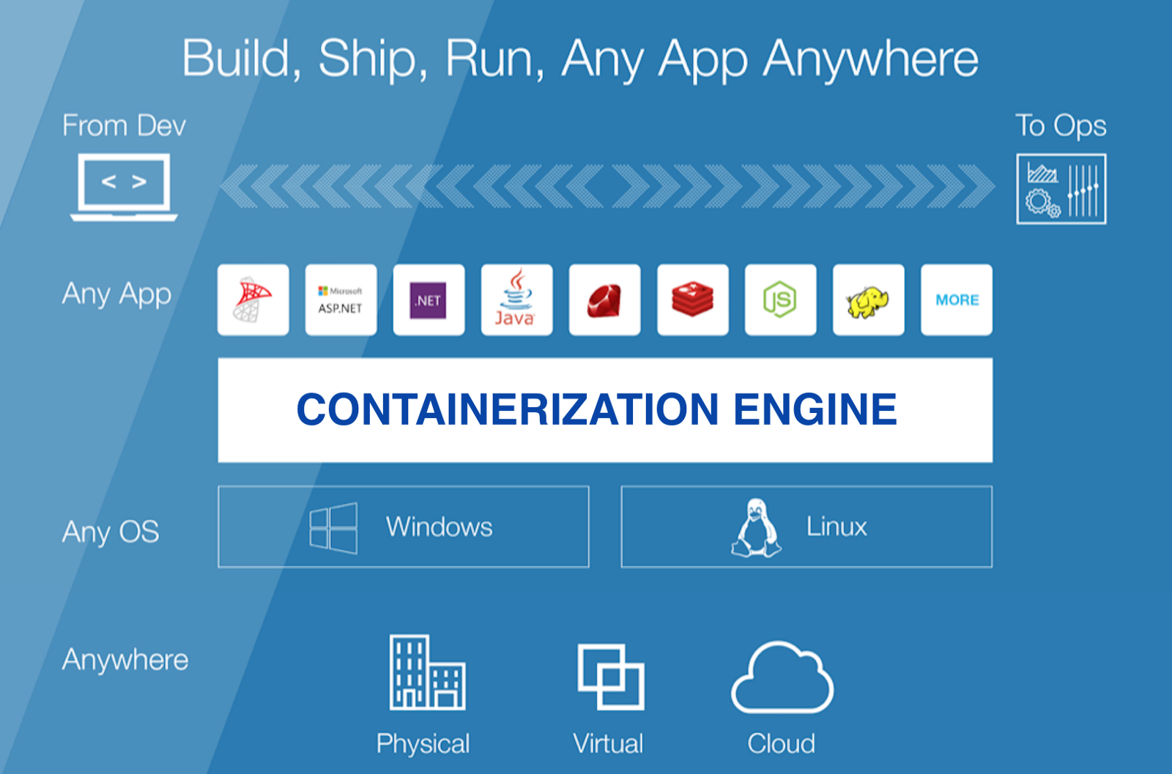
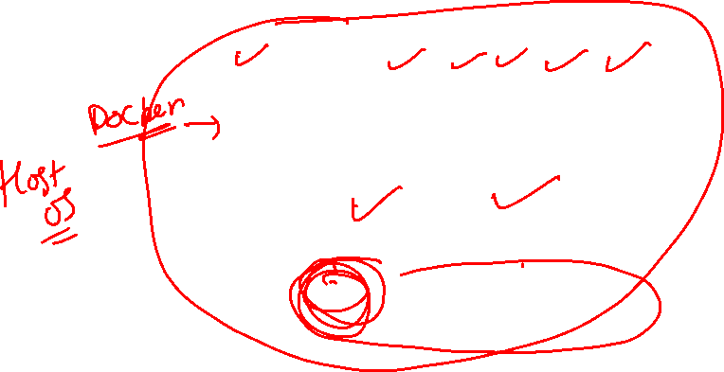
1.16 Container Platform
Containerization platform: It can be defined as a technology to isolate processes from each other, in such a manner that processes run like they are running in a normal operating system which is enforced by the container runtime.
Source: https://1.bp.blogspot.com/-kx-LtOGIwqU/XOzPWiztcVI/AAAAAAAAIvE/qURId5PRX40aV-TFJ-B7GA8t5CqAUF_3gCEwYBhgL/s1600/docker.png
Notes:
Notes to the Facilitator: Describe what is container platform.
Notes to the Participants:
Containerization Platform: It can be defined as a technology to isolate processes from each other in such a manner that processes run like they are running in a normal operating system which is enforced by the container runtime. They ideally share the resources of a single host machine without having the ability to see each other's or the host's processes and resources because of namespaces and cgroups. A platform also has a control over the runtime and the lifecycle of the images.
It can also be defined as a tool or technology, which provides the functionality to spin up containers with the extraction at the software level and not at the hardware level like virtual Machines. Examples: LXC, Rkt, Docker.

Slide 20
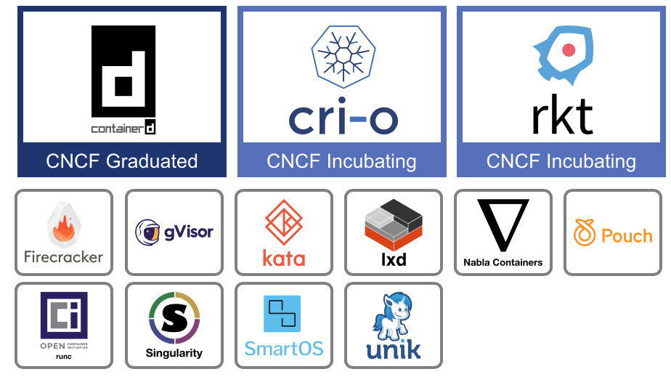
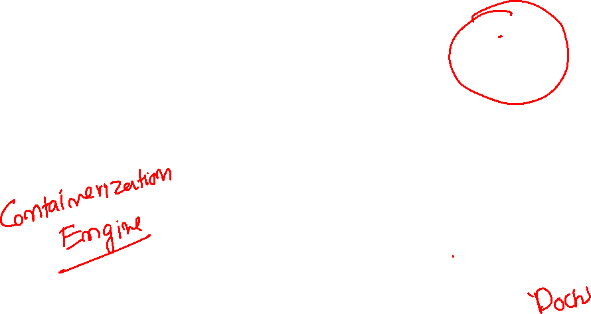
1.17 Container Runtime
Container runtime: It is a Container execution environment, which ensures the allocation of limited shares of resources (e.g., CPU, memory, disk) to the containerized application, also exposes the services and APIs and tools for managing containers.
Source: https://miro.medium.com/max/2486/1*OnB-Ah-FehjzQfhu5-BHmQ.png
Notes:
Notes to the Facilitator: Explain container runtime.
Notes to the Participants:
Container runtime: It is a container execution environment, which ensures the allocation of limited shares of resources (e.g., CPU, memory, disk) to the containerized application, also exposes the services and APIs and tools for managing containers. It acts as a layer between the host machine and the containers fulfilling all sorts of requirements like port and volume mapping needed to achieve containerized services. Examples: LXD, Docker daemon, Rkt process.

Slide 21


Virtual Machines vs Docker Containers

Slide 22

What did you Grasp?
What is the main difference between Containerisation and Virtualization?
Lifecycle
Isolation
Extraction at software level
Extraction at hardware level
Notes:
Notes to the Facilitator:
Answer: A. Extraction at software level

Slide 23


1.18 Container Images
Image: Images are readable files which will be used to spin up containers. An image deﬁnes the ﬁle system and execution parameters for the container. Images can be layered, composable, depending on the format of the runtime.
Source: https://s3.amazonaws.com/dev.assets.neo4j.com/wp-content/uploads/20160112150631/image-layers-docker.png
Notes:
Notes to the Facilitator: Explain what are container images.
Notes to the Participants:
Image: Images are readable files which will be used to spin up containers. An image deﬁnes the ﬁlesystem and execution parameters for the container. Images can be layered, composable, depending on the format of the runtime.
If need to be defined in terms of application, it can be stated that an image has all the dependencies encapsulated to fulfill the requirement. For example an image of node.js application will have node binaries and application code. Examples: Docker image, appc, LXC image format.

Slide 24



Slide 25

1.23 Docker
In 2013, the first version of Docker was introduced. Developed by Google engineers collaborating with Docker over libcontainer and porting the core concepts and abstractions to libcontainer.
Source: https://i0.wp.com/www.docker.com/blog/wp-content/uploads/011f3ef6-d824-4d43-8b2c-36dab8eaaa72-1.jpg?fit=650%2C530&ssl=1
Notes:
Notes to the Facilitator: Describe the Docker containers.
Notes to the Participants: In 2013, the first version of Docker was introduced. Developed by Google engineers collaborating with Docker over libcontainer and porting the core concepts and abstractions to libcontainer.
The major aspects because of which docker is still running are as follows:
Promoting microservice architecture: As more organisation are moving towards microservice architecture, docker has been fulfilling such requirements. Docker is continuing to prove its capability with enhanced monitoring, storage, security, and delivery chains.
Bringing development and operations together: Docker is the first DevOps tool that's as popular with developers as it is with ops engineers. The reason being, developers can work inside the containers, and ops engineers can work outside the containers in parallel.
Consistency in continuous integration: Containers are able to run anywhere, enhancing Continuous Delivery and Deployment on Linux, Windows, and Mac operating systems on virtual machines or bare metal, on a contributor’s machine or in data centers on-premises; and in the public cloud as well.
Delivery chains: It simplifies software delivery chains by providing environment parity and convenience in deploying an app for multiple types of environments. To take advantage of the Docker’s benefits in this respect, we need a robust delivery chain.

Slide 26


2.10 Advantages and Drawbacks of Containerization
Now, we will discuss the advantages and disadvantages of containerization.
Notes:
Notes to the Facilitator:
Explain the participants about the advantages and disadvantages of containerization.
Notes to the Participants:
We discussed about how containerisation works and now we will discuss what could be the merits and demerits of it. Since, it is subjective that docker could be beneficial for some use cases, but yet it could be a hassle for the application which works just fine on VMs.

Slide 27
2.10.1 Advantages of Containerization
Some advantages of Docker are as follows:
Cost saving
Standardization and productivity
Rapid deployment
Isolution
Security
Advantages
Notes:
Notes to the Facilitator:
Inform the participants about the advantages of containerization.
Notes to the Participants:
Some of the advantages of containerization are as follows:
Cost Saving: Docker uses what it needs, hence the wastage of resources is quite minimal, and having multiple microservices running the return of investment is good in the long run.
Standardization and productivity: Docker brings a standard in whole build and release cycle which is quite reliable and saves time, hence ends up increasing productivity.
Rapid deployment: Docker is widely known for its shipping capabilities, since all sorts of dependencies are encapsulated in one image, hence shipping it and deploying becomes easier.
Isolation: Because of the technologies like c-groups and namespaces, Docker is quite advanced in terms of providing isolation compared to other container technologies. We don’t have to worry about the environment anymore or the software configuration of that environment, because a docker image is capable enough to provide the suitable environment to the encapsulated application.
Security: Security is sacrosanct in Docker containers which is a default feature, hence they are quite secure. The security feature can also be taken to another level if you run your processes as non-privileged users inside the container. To meet the security benchmarks, you can add an extra layer of safety by enabling AppArmor, SELinux, GRSEC, or another appropriate hardening system.

Slide 28
2.10.2 Disadvantages of Containerization
Some disadvantages of Docker are as follows:
Bare metal speed is better than container
Ecosystem of a container
Persistent data storage
Containers are not compatible with all types of application
Disadvantages
Notes:
Notes to the Facilitator:
Explain the participants about the disadvantages of containerization.
Notes to the Participants:
Some of the disadvantages of containerization are as follows:
Bare metal speed is better than container: Containers are known to consume resources more efficiently than virtual machines. But due to overlay networking, interfacing between containers and the host system, they are still doubted for performance overhead, interfacing between container,s and the host system and so on. To utilise maximum resources and if you want 100 percent performance, then bare metal is a wiser choice than containers.
Ecosystem of a container: Running containers in production needs an orchestrator which is a much needed platform. Usually they are open source, but some container products don't work with other ones majorly due to due to competition among the companies that back them. For example, OpenShift only works with the Kubernetes orchestrator.
Persistent data storage: Containers are designed for running stateless applications which don’t need to keep data with them, because once a container dies all of its data is not retrievable unless you save it somewhere else first. There are certain ways to save data persistently in Docker, such as docker volume mount and bind.
Containers are not compatible with all types of application: Containers works well with microservices which are discreet in nature and usually stateless, but if the application is monolithic it won’t be wise to run it in docker, since you won’t be reaping benefits of docker with monolithic application.

Slide 29
Docker Commands (Hands-On)
docker –version
docker pull
docker run
docker ps
docker ps -a
docker run -it
docker stop
docker login
docker push
docker images
docker rm
docker rmi
docker build

